Slide 1
AEP Consortium Meeting
April 20, 2021

Slide 3
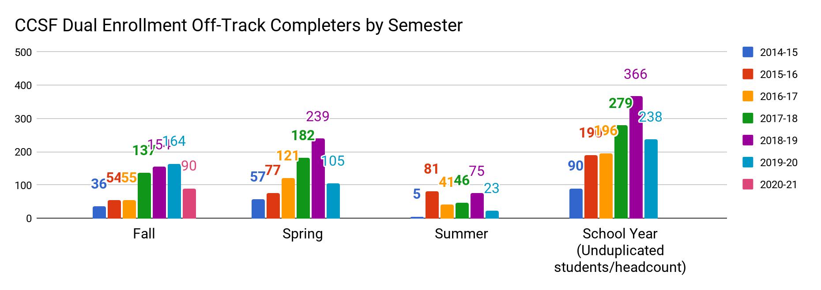
College & Career Readiness Early College Team
Increasing # of Off Track Students Served at CCSF

Slide 4
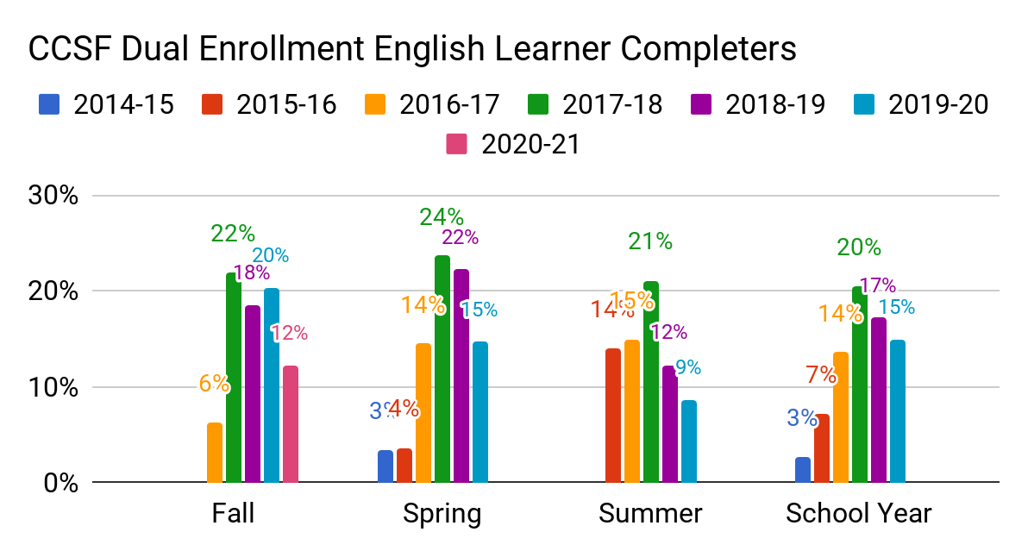
College & Career Readiness Early College Team
Changing WHO is served at CCSF
Number of CCSF Dual Enrollment Completers Who Are English Learners
 | Fall | Spring | Summer | School Year
2014-15 | * | 12/355 | * | 13/486
2015-16 | * | 13/356 | 34/243 | 51/712
2016-17 | 20/320 | 77/532 | 33/221 | 119/876
2017-18 | 111/506 | 151/638 | 66/313 | 235/1149
2018-19 | 109/590 | 201/904 | 93/756 | 313/1823
2019-20 | 161/793 | 93/635 | 28/326 | 210/1406
2020-21 | 101/830
An asterisk (*) appears on the charts to protect student privacy where there are ten or fewer students.

Slide 5
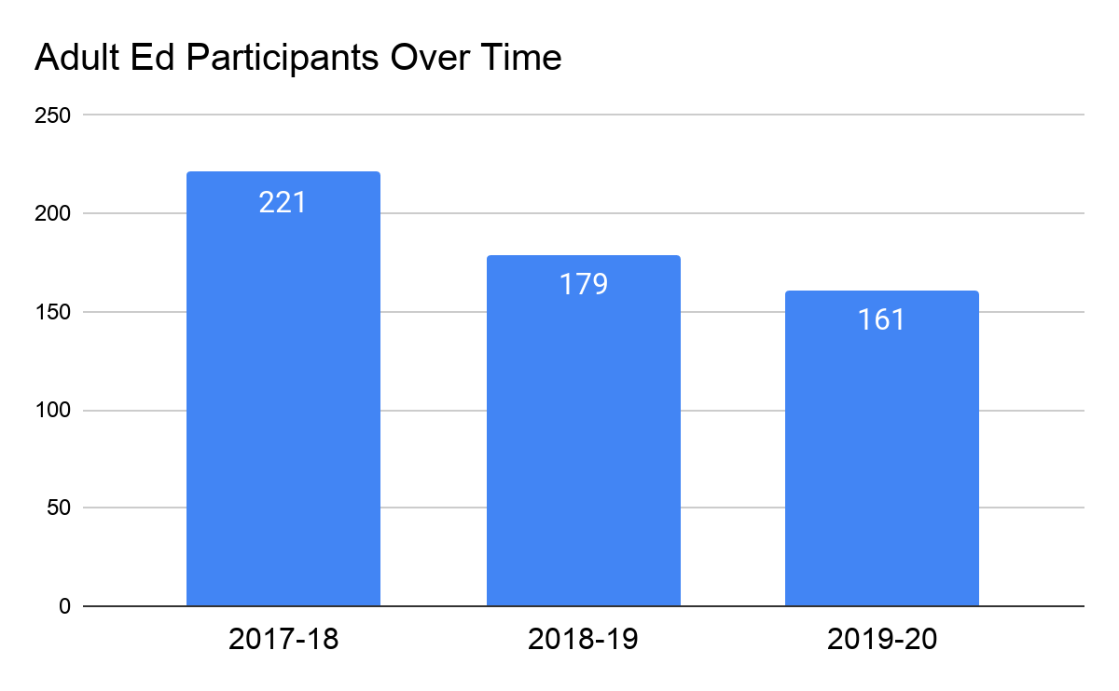

Slide 6
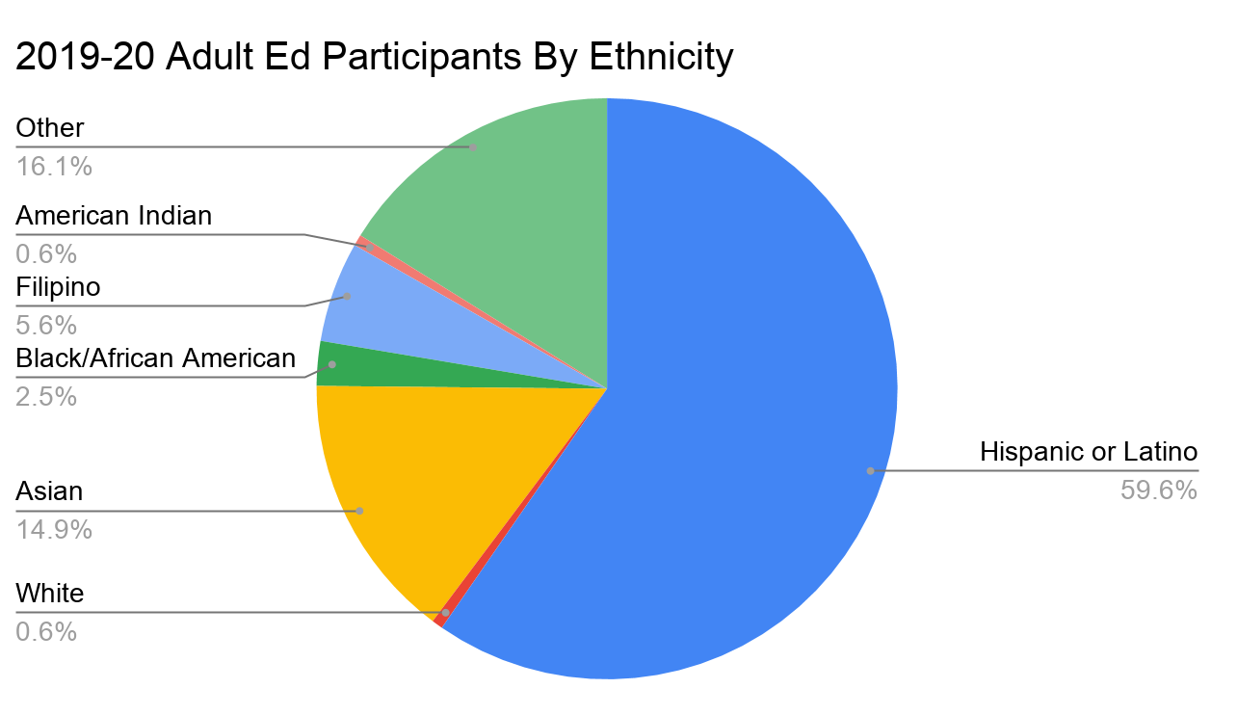
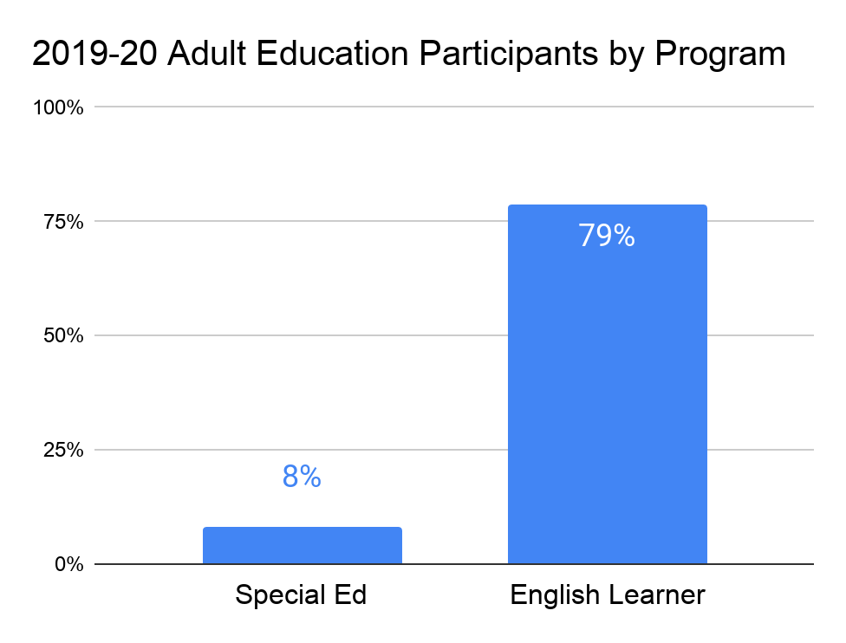
AEP Participant Data

Slide 7
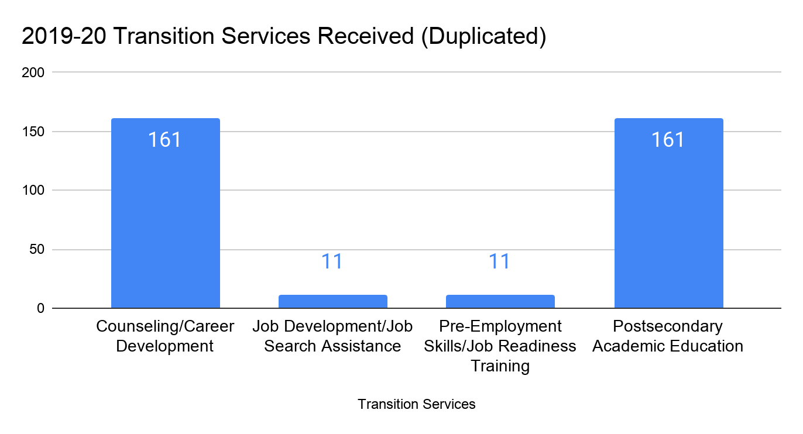
Services Provided

Slide 8
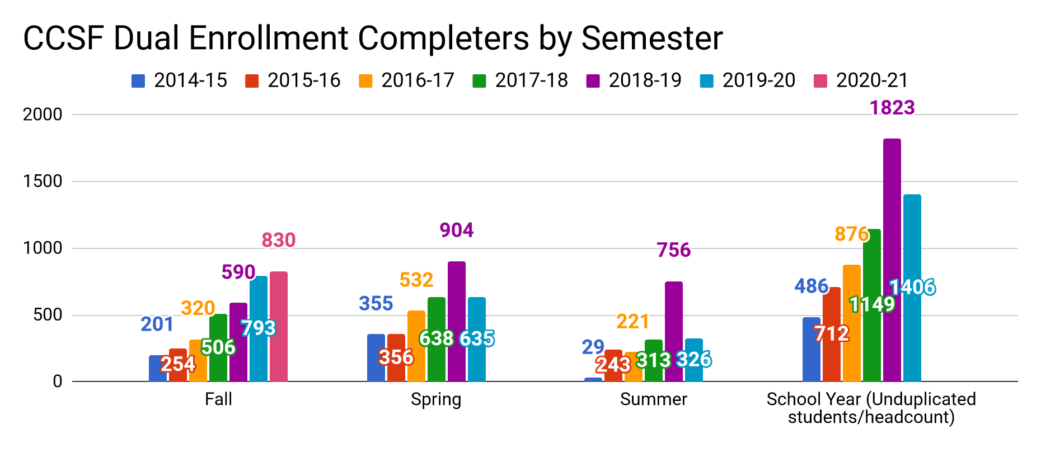
College & Career Readiness Early College Team
Increasing # of Students Served at CCSF Dual Enrollment

Slide 9
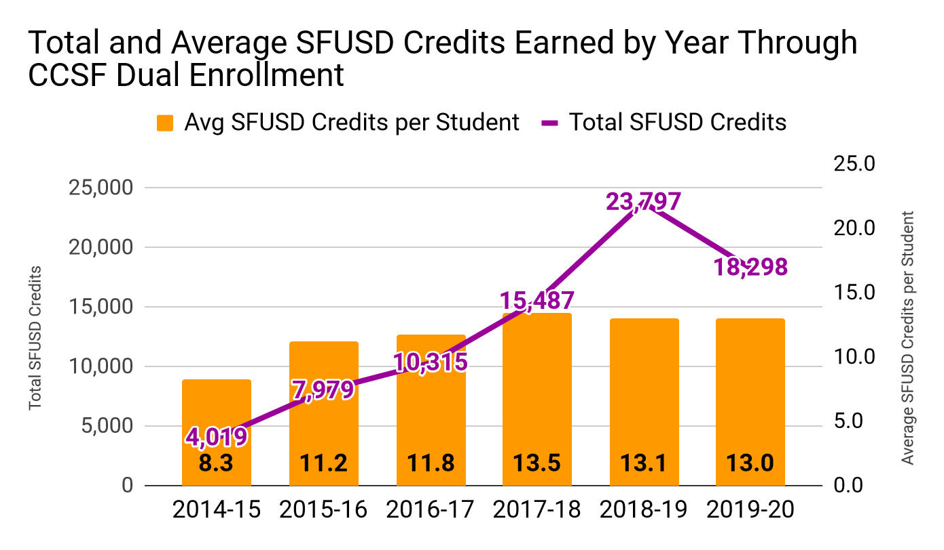
Students Earning More SFUSD-Equivalent Credits Each Year Through Dual Enrollment

Slide 10
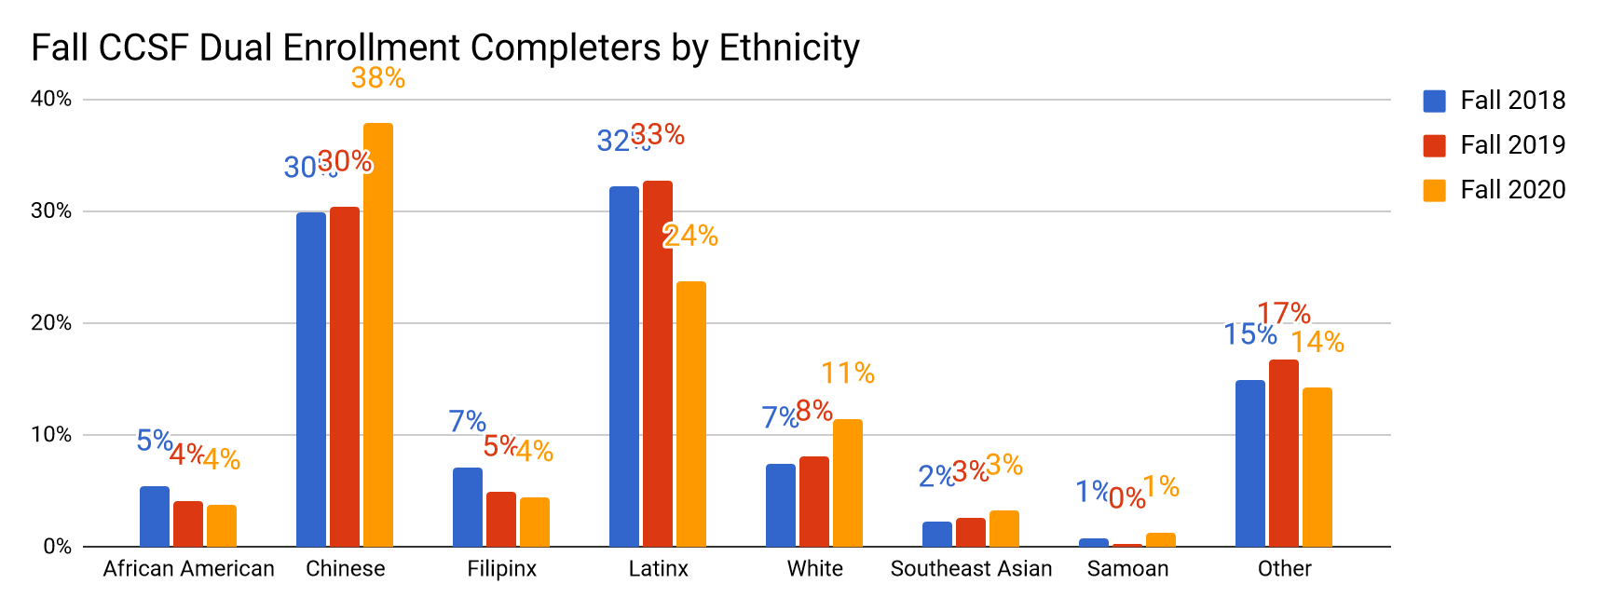
College & Career Readiness Early College Team
Changing WHO is served at CCSF (Ethnicity)

